Slide 1
Force Analysis of Gear
Tribhuwan University
Institute of Engineering
Pulchowk Campus
Tutorial By:
Nipesh Regmi
Department of Mechanical Engineering

Slide 2
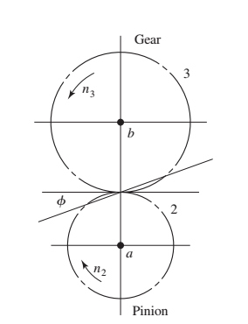
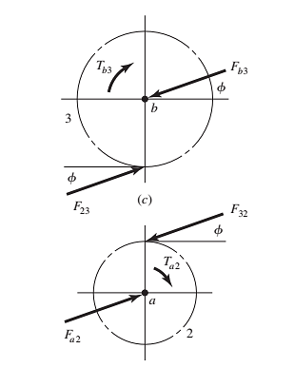
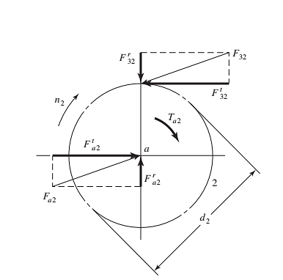

SPUR GEAR Terminology
Resolution of pinion forces
Simple gear train
Free-body diagrams of
forces and moments on pinion and gear

Slide 3
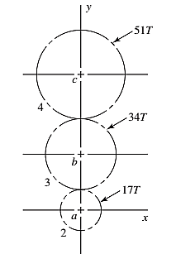

Force Analysis of SPUR GEAR
Shaft a in the figure has a power input of 75 kW at a speed of 1000 rev/min in the counter clockwise direction. The gears have a module of 5 mm and a $20°$ pressure angle. Gear 3 is an idler.
Draw a free-body diagram of all the gears and show all the forces that act upon it.

Slide 4
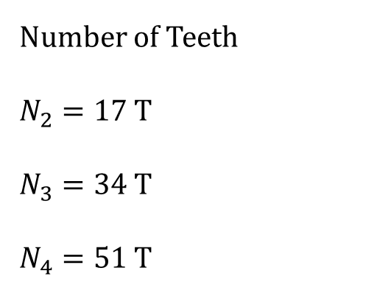
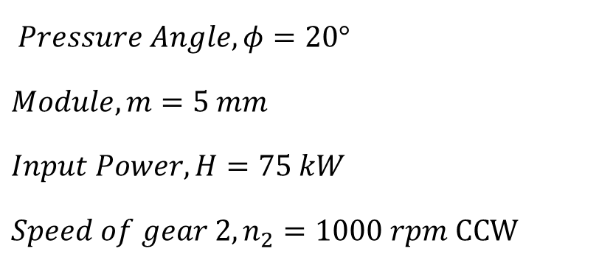
Force Analysis of SPUR GEAR Solution
Number of Teeth
$N_{2}=17$ T
$N_{3}=34$ T
$N_{4}=51$ T
Gear 3 is an idler gear. So it transmits no power (torque) to its shaft.
$Pressure Angle, φ=20°$
$$Module, m=5 mm$$
$$Input Power, H=75 kW$$
$$Speed of gear 2, n_{2}=1000 rpm CCW$$

Slide 5
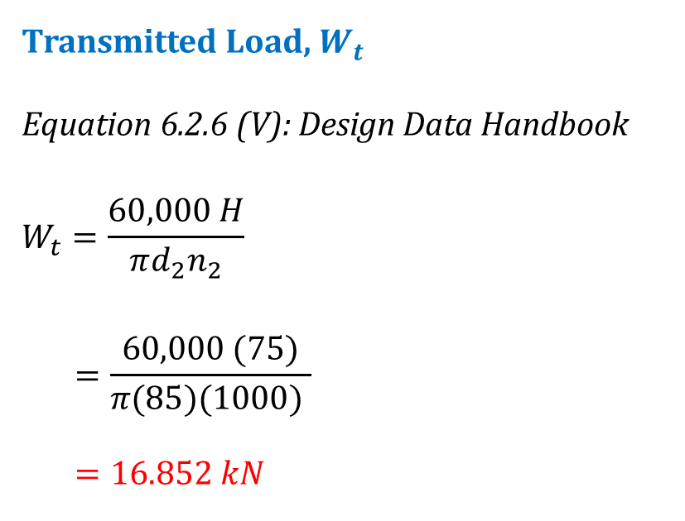
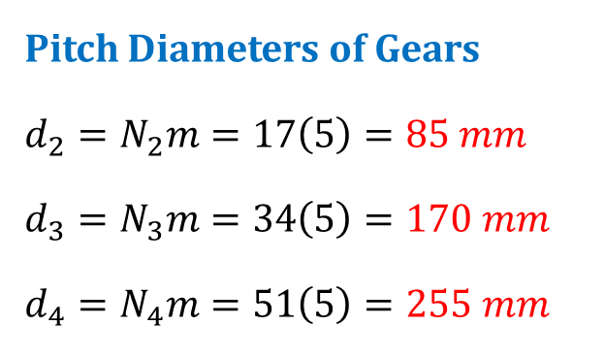
Force Analysis of SPUR GEAR Solution CONTD…
Pitch Diameters of Gears
$$d_{2}=N_{2}m=17\left(5\right)=85 mm$$
$$d_{3}=N_{3}m=34\left(5\right)=170 mm$$
$$d_{4}=N_{4}m=51\left(5\right)=255 mm$$
Transmitted Load, $W_{t}$
Equation 6.2.6 (V): Design Data Handbook
$$W_{t}=\frac{60,000 H}{πd_{2}n_{2}}$$
$$=\frac{60,000 (75)}{π(85)(1000) }$$
$$=16.852 kN$$
What is diametral pitch P and module, m ???
Notes:
Diametral Pitch (P), teeth per inch:
The ratio of the number of teeth on the gear to the pitch circle diameter. Used only with U.S. units.
Module, m:
The ratio of the pitch circle diameter to the number of teeth. Used in SI system. It has unit of mm.

Slide 6

















Force Analysis of SPUR GEAR Solution CONTD…
FBD of GEAR 2, 3 & 4
$$F_{c4}^{y}$$
$$F_{c4}^{x}$$
Line of action of
Gear 3 & Gear 4
$$F_{43}^{r}$$
$$T_{c4}$$
Gear 4
$$F_{34}^{t}$$
$$F_{43}^{t}$$
$$0$$
$$F_{34}^{r}$$
$$F_{b3}^{x}$$
$$F_{b3}^{y}$$
Gear 3
$$F_{23}^{t}$$
$$F_{32}^{r}$$
$$F_{32}^{t}$$
$$F_{23}^{r}$$
Line of action of
Gear 2 & Gear 3
Y, r
Gear 2
$$T_{a2}$$
$$F_{a2}^{x}$$
$$F_{a2}^{y}$$
X, t
Notes:
Diametral Pitch (P), teeth per inch:
The ratio of the number of teeth on the gear to the pitch circle diameter. Used only with U.S. units.
Module, m:
The ratio of the pitch circle diameter to the number of teeth. Used in SI system. It has unit of mm.

Slide 7
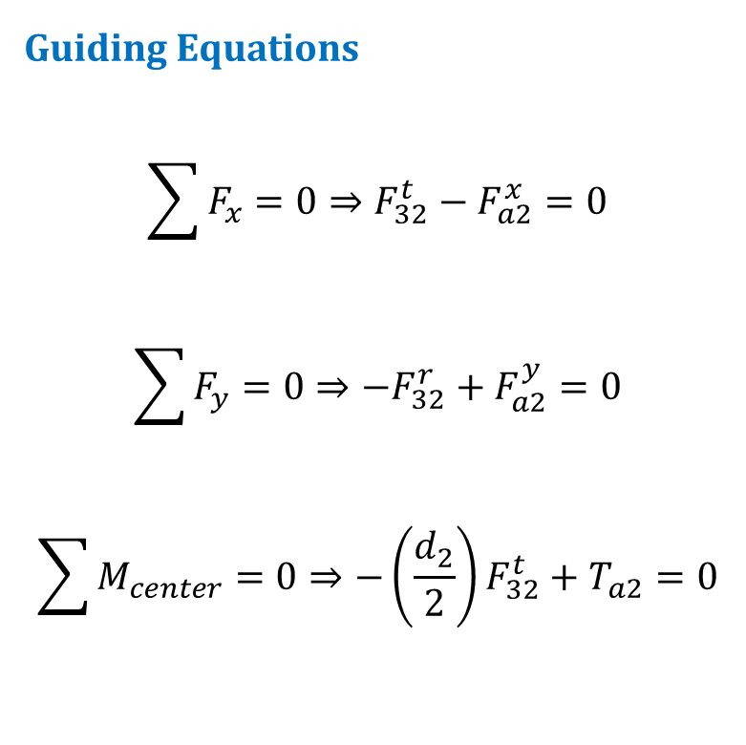
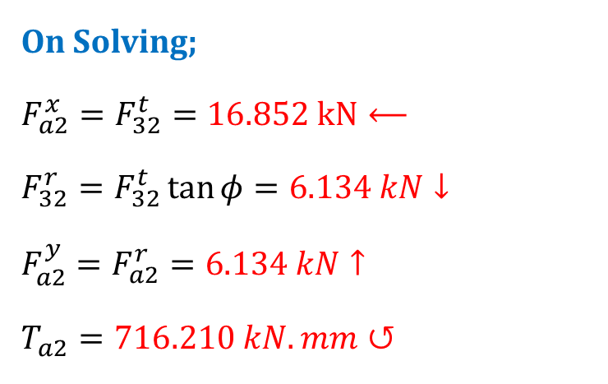
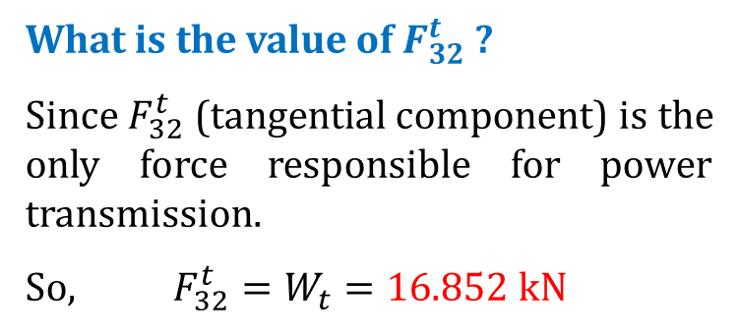
Force Analysis of SPUR GEAR Solution CONTD…
Forces & Torque on GEAR 2
Y, r
X, t
Guiding Equations
$$\sum{F_{x}=0⇒F_{32}^{t}−F_{a2}^{x}=0}$$
$$\sum{F_{y}=0⇒{−F}_{32}^{r}+F_{a2}^{y}=0}$$
$$\sum{M_{center}=0⇒{−\left(\frac{d_{2}}{2}\right)F}_{32}^{t}+T_{a2}=0}$$
$$F_{32}^{r}$$
What is the value of $F_{32}^{t}$ ?
Since $F_{32}^{t}$ (tangential component) is the only force responsible for power transmission.
So, $F_{32}^{t}=W_{t}=16.$852 kN
$$F_{32}^{t}$$
$$T_{a2}$$
$$F_{a2}^{x}$$
$$F_{a2}^{y}$$
On Solving;
$$F_{a2}^{x}=F_{32}^{t}=16.852 kN⟵$$
$$F_{32}^{r}=F_{32}^{t}\tan{φ}=6.134 kN↓$$
$$F_{a2}^{y}=F_{a2}^{r}=6.134 kN↑$$
$$T_{a2}=716.210 kN.mm↺$$
Notes:
Diametral Pitch (P), teeth per inch:
The ratio of the number of teeth on the gear to the pitch circle diameter. Used only with U.S. units.
Module, m:
The ratio of the pitch circle diameter to the number of teeth. Used in SI system. It has unit of mm.

Slide 8
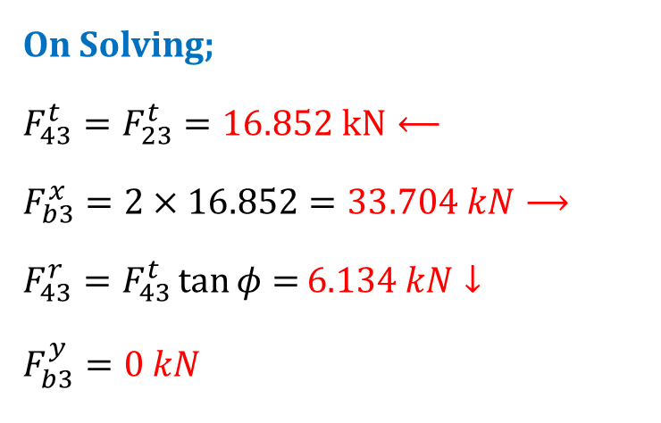

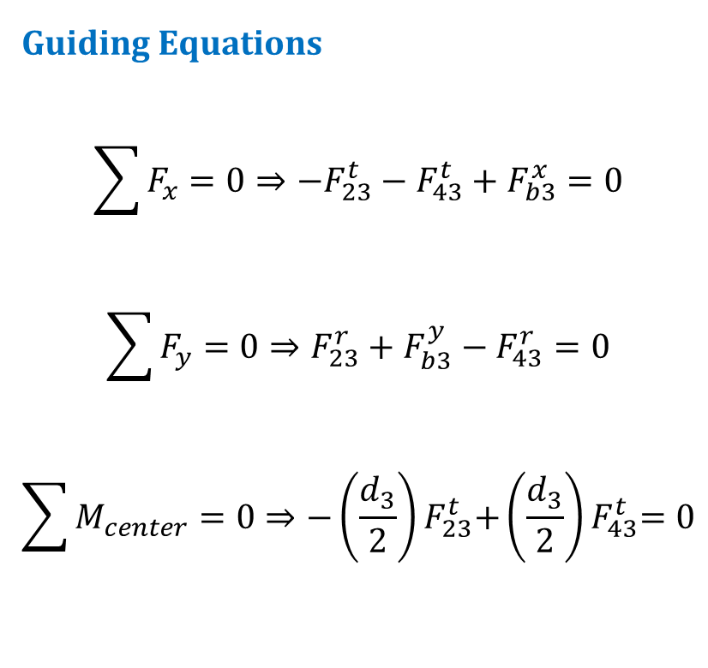
Force Analysis of SPUR GEAR Solution CONTD…
Forces & Torque on GEAR 2
Y, r
X, t
Guiding Equations
$$\sum{F_{x}=0⇒{−F}_{23}^{t}−F_{43}^{t}+F_{b3}^{x}=0}$$
$$\sum{F_{y}=0⇒F_{23}^{r}+F_{b3}^{y}−F_{43}^{r}=0}$$
$$\sum{M_{center}=0⇒{−\left(\frac{d_{3}}{2}\right)F}_{23}^{t}{+\left(\frac{d_{3}}{2}\right)F}_{43}^{t}=0}$$
$$F_{43}^{r}$$
$$F_{23}^{t}=F_{32}^{t}=16.852 kN⟵$$
$$F_{23}^{r}=F_{32}^{r}=6.134 kN↑$$
$$F_{43}^{t}$$
$$0$$
$$F_{b3}^{x}$$
$$F_{b3}^{y}$$
On Solving;
$$F_{43}^{t}=F_{23}^{t}=16.852 kN⟵$$
$$F_{b3}^{x}=2×16.852=33.704 kN⟶$$
$$F_{43}^{r}=F_{43}^{t}\tan{φ=}6.134 kN↓$$
$$F_{b3}^{y}=0 kN$$
$$F_{23}^{t}$$
$$F_{23}^{r}$$
Notes:
Diametral Pitch (P), teeth per inch:
The ratio of the number of teeth on the gear to the pitch circle diameter. Used only with U.S. units.
Module, m:
The ratio of the pitch circle diameter to the number of teeth. Used in SI system. It has unit of mm.

Slide 9
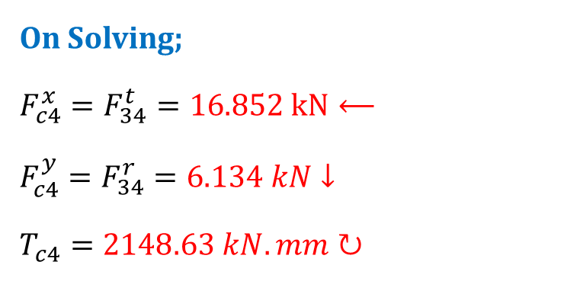


Force Analysis of SPUR GEAR Solution CONTD…
Forces & Torque on GEAR 3
Y, r
X, t
Guiding Equations
$$\sum{F_{x}=0⇒F_{34}^{t}−F_{c4}^{x}=0}$$
$$\sum{F_{y}=0⇒F_{34}^{r}+F_{c4}^{y}=0}$$
$$\sum{M_{center}=0⇒{\left(\frac{d_{4}}{2}\right)F}_{34}^{t}−T_{c4}=0}$$
$$F_{34}^{t}=F_{43}^{t}=16.852 kN→$$
$$F_{34}^{r}=F_{43}^{r}=6.134 kN↑$$
$$F_{c4}^{y}$$
$$F_{c4}^{x}$$
$$T_{c4}$$
On Solving;
$$F_{c4}^{x}=F_{34}^{t}=16.852 kN⟵$$
$$F_{c4}^{y}=F_{34}^{r}=6.134 kN↓$$
$$T_{c4}=2148.63 kN.mm↻$$
$$F_{34}^{t}$$
$$F_{34}^{r}$$
Notes:
Diametral Pitch (P), teeth per inch:
The ratio of the number of teeth on the gear to the pitch circle diameter. Used only with U.S. units.
Module, m:
The ratio of the pitch circle diameter to the number of teeth. Used in SI system. It has unit of mm.

Slide 10
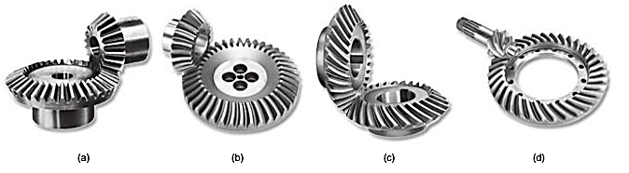
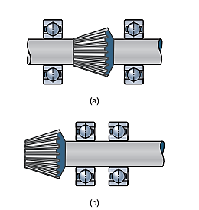
BEVEL GEAR
Notes:
Left figure: Types of Bevel Gear
A straight bevel gear set b) A Zerol gear set
c) A spiral bevel gear set d) A hypoid bevel gear set
Right Figure: Types of Bevel Gear mountings
Straddle mounting, where gear is located between bearings
Overhang mounting.

Slide 11
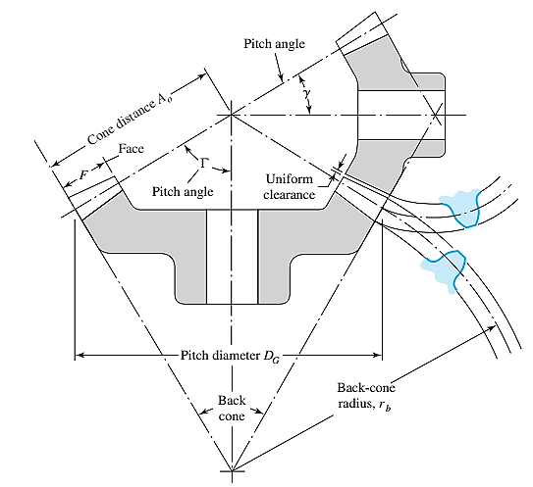


BEVEL GEAR Terminology
Pitch Angle
The angle that the pitch line makes with the axis of the gear.
Also sometimes referred to as center angle.
$γ=Pitch angle for pinion (Driving gear)$
$$Γ=Pitch angle for gear (Driven gear)$$
Determination of Pitch angle
$$γ=\tan^{−1}\left(\frac{D_{P}}{D_{G}}\right) and Γ=\tan^{−1}\left(\frac{D_{G}}{D_{P}}\right)$$

Slide 12
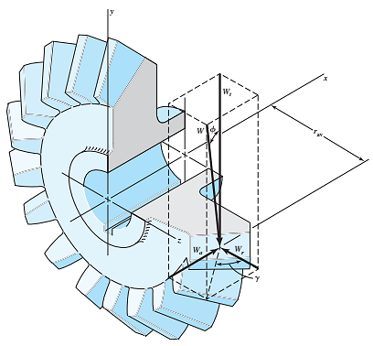

BEVEL GEAR Terminology
Magnitude of Forces on Bevel Gear
$$W_{t}=Tangential Component=Transmitted load=\frac{T}{r_{av}}$$
$$W_{r}=Radial Component=W_{t}\tan{φ}\cos{γ}$$
$$W_{a}=Axial or Thrust Component=W_{t}\tan{φ}\sin{γ}$$
Where, $φ=Pressure angle;T=Transmitted Torque;$
$$r_{av}=mean radius for the gear under consideration$$

Slide 13

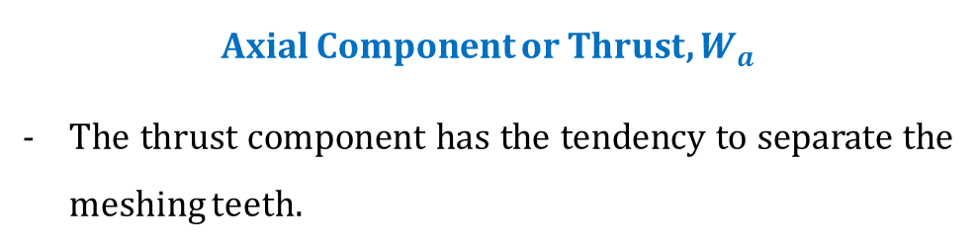

BEVEL GEAR Terminology
Direction of Forces on Bevel Gear
Tangential Component, $W_{t}$
Direction of tangential component for the driving gear (Pinion) is opposite to the direction of rotation.
Direction of tangential component for the driven gear (Gear) is same as the direction of rotation.
Radial Component, $W_{r}$
Direction of radial component for the driving gear (Pinion) is towards the center of the pinion.
Direction of radial component for the driven gear (Gear) is also towards the center of the gear.
Axial Component or Thrust, $W_{a}$
The thrust component has the tendency to separate the meshing teeth.

Slide 14
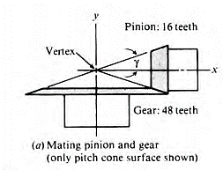
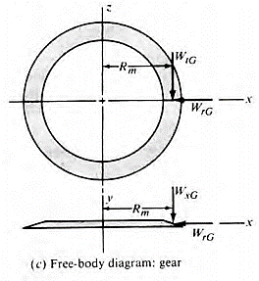
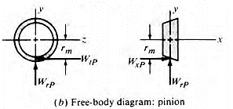
BEVEL GEAR Terminology
Direction of Forces on Bevel Gear Illustration

Slide 15
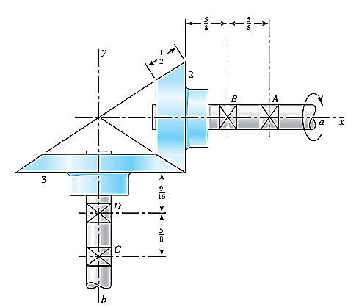

Force analysis of BEVEL GEAR
The figure shows a $10$ diametral pitch $18$ – tooth $20°$ straight bevel pinion driving a 30 – tooth gear. The transmitted load is $25 lbf$. Find the bearing reactions at C and D on the output shaft if D is to take the thrust loads.

Slide 16
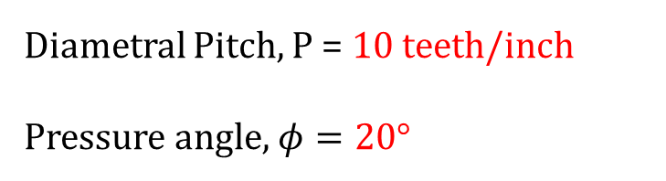



Force analysis of BEVEL GEAR Solution
Pitch Angles
$$γ=\tan^{−1}\left(\frac{d_{P}}{d_{G}}\right)=\tan^{−1}\left(\frac{1.8}{3}\right)=30.96°$$
$$Γ=\tan^{−1}\left(\frac{d_{G}}{d_{P}}\right)=\tan^{−1}\left(\frac{3}{1.8}\right)=59.04°$$
Diametral Pitch, P = 10 teeth/inch
Pressure angle, $φ=20°$
Pinion
Teeth Number, $N_{P}=18 T$
Pitch diameter, $d_{P}=\frac{N_{P}}{P}$
$$=\frac{18}{10}=1.8 inch$$
Gear
Teeth Number, $N_{G}=30 T$
Pitch diameter, $d_{G}=\frac{N_{G}}{P}$
$$=\frac{30}{10}=3 inch$$

Slide 17
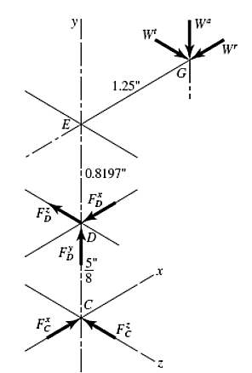

Force analysis of BEVEL GEAR Solution CONTD…
FBD of GEARSHAFT
0.6911”
$$DE=\frac{9}{16}+0.5×\left(\frac{1}{2}\cos{Γ}\right)$$
$$=\frac{9}{16}+0.5×\left(\frac{1}{2}\cos{59.04}\right)$$
$$=0.6911"$$
T

Slide 18
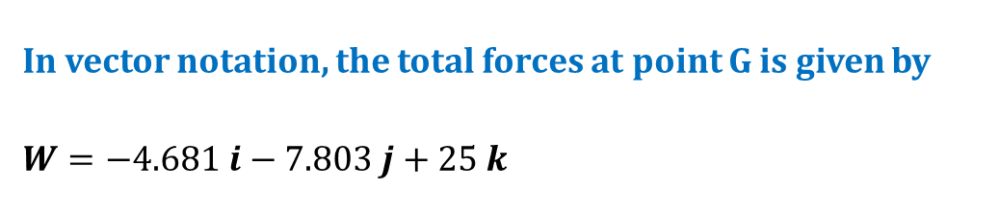
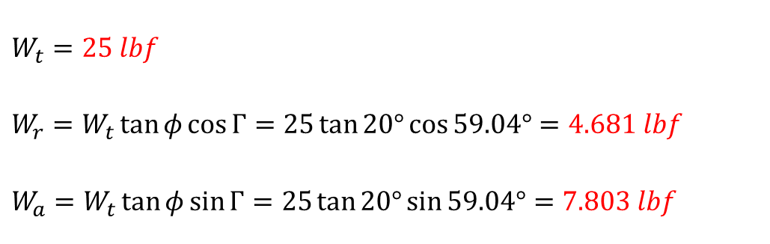
Force analysis of BEVEL GEAR Solution CONTD…
Force components on Bevel gear
$$W_{t}=25 lbf$$
$$W_{r}=W_{t}\tan{φ}\cos{Γ}=25\tan{20°}\cos{59.04°}=4.681 lbf$$
$$W_{a}=W_{t}\tan{φ}\sin{Γ}=25\tan{20°}\sin{59.04°}=7.803 lbf$$
0.6911”
In vector notation, the total forces at point G is given by
$$W=−4.681 i−7.803 j+25 k$$
T

Slide 19

Force analysis of BEVEL GEAR Solution CONTD…
Force components on Bevel gear
Equations of Equilibrium
$$\sum{F=0}$$
$$\sum{M_{D}=R_{CD}×F_{C}+R_{GD}×W+T=0}$$
0.6911”
T

Slide 20

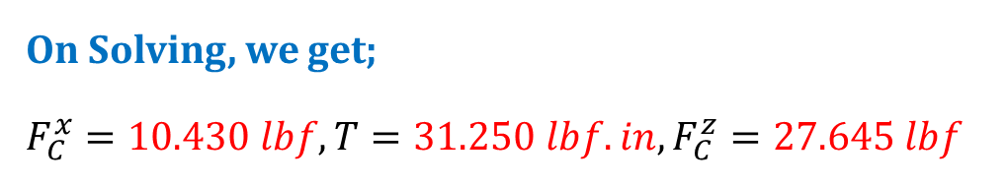
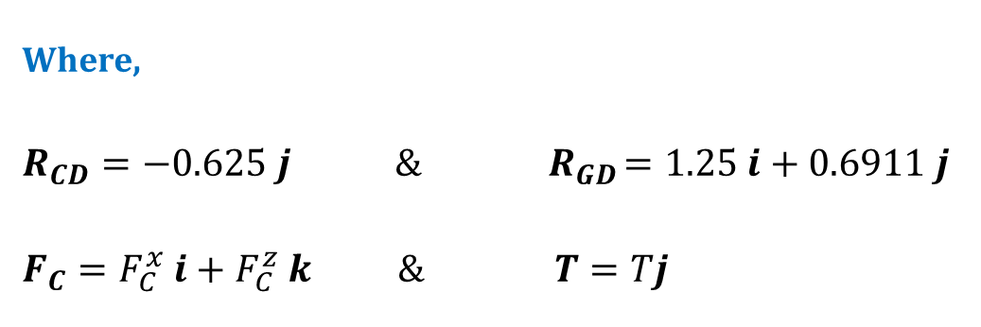
Force analysis of BEVEL GEAR Solution CONTD…
Force components on Bevel gear
Using second equilibrium Equation
$$\sum{M_{D}=R_{CD}×F_{C}+R_{GD}×W+T=0}$$
$$⇒−0.625j×\left(F_{C}^{x}i+F_{C}^{z}k\right)+\left(1.25i+0.6911j\right)×\left(−4.681i−7.803j+25k\right)+Tj=0$$
$$⇒\left(0.625F_{C}^{x}−6.519\right)k+\left(−31.250+T\right)j+\left(−0.625F_{C}^{z}+17.278\right)i=0$$
Where,
$$R_{CD}=−0.625 j \& { R}_{GD}=1.25 i+0.6911 j$$
$$F_{C}=F_{C}^{x} i+F_{C}^{z} k \& T=Tj$$
On Solving, we get;
$$F_{C}^{x}=10.430 lbf, T=31.250 lbf.in, F_{C}^{z}=27.645 lbf$$

Slide 21

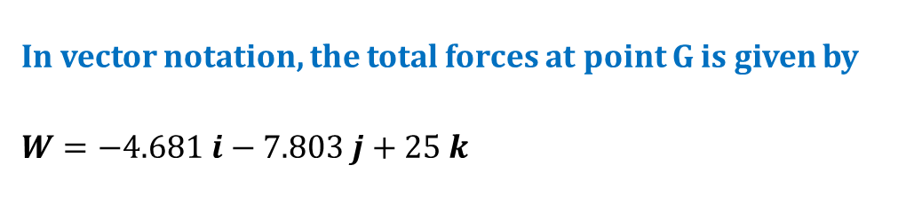
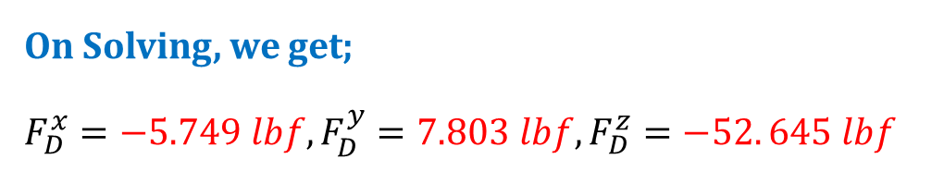
Force analysis of BEVEL GEAR Solution CONTD…
Force components on Bevel gear
Using first equilibrium Equation
$$\sum{F=W+F_{C}+F_{D}=0}$$
$$⇒\left(−4.681i−7.803j+25k\right)+\left(10.430i+27.645k\right)+\left(F_{D}^{x}i+F_{D}^{y}j+F_{D}^{z}k\right)=0$$
$$⇒\left(−4.681+10.430+F_{D}^{x}\right)i+\left(−7.803+F_{D}^{y}\right)j+\left(25+27.645+F_{D}^{z}\right)k=0$$
In vector notation, the total forces at point G is given by
$$W=−4.681 i−7.803 j+25 k$$
On Solving, we get;
$$F_{D}^{x}=−5.749 lbf, F_{D}^{y}=7.803 lbf, F_{D}^{z}=−52. 645 lbf$$

Slide 22
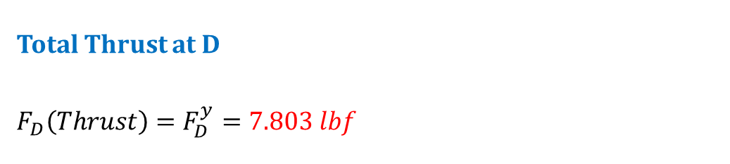
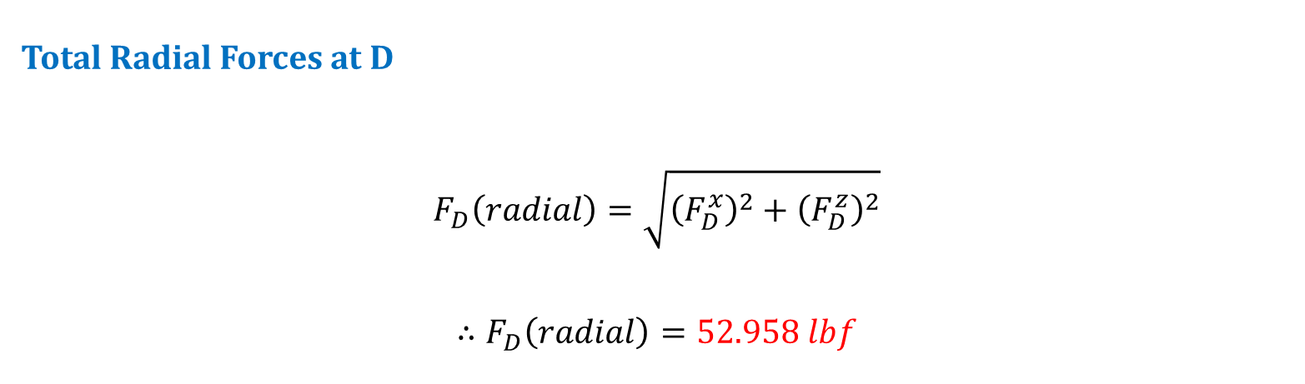
Force analysis of BEVEL GEAR Solution CONTD…
Force components on Bevel gear
Total Radial Forces at D
$$F_{D}\left(radial\right)=\sqrt{{\left(F_{D}^{x}\right)}^{2}+{\left(F_{D}^{z}\right)}^{2}}$$
$$∴F_{D}\left(radial\right)=52.958 lbf$$
0.6911”
Total Thrust at D
$$F_{D}\left(Thrust\right)=F_{D}^{y}=7.803 lbf$$
T

Slide 23
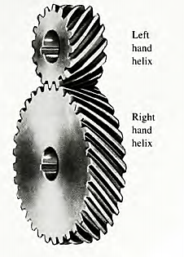
Helical Gear
Helical Gears

Slide 24
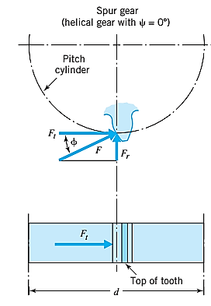


Helical Gear Terminology
Notes:
$$F_{b}=F_{t}+F_{a}$$
$$F=F_{b}+F_{r}$$

Slide 25




Helical Gear Terminology
$$W_{r}=W \sin{φ_{n}}$$
$$W_{t}=W\cos{φ_{n}}\cos{ψ}$$
$$W_{a}=W\cos{φ_{n}}\sin{ψ}$$
Note :
$\tan{φ_{n}}=\tan{φ_{t}}\cos{ψ}$
$$W=Total force$$
$$W_{r}=Radial Component$$
$$W_{t}=Tangential Component, also called transmitted load$$
$$W_{a}=axial component, also called the thrust load$$
$$φ_{n}=normal pressure angle$$
$$φ_{t}=transverse or simply pressure angle$$
$$ψ=helix angle$$
Notes:
For helical gears, helix angle and one of the other two are specified. In this case the third angle can be found from the relation:
$$\tan{φ_{n}}=\tan{φ_{t}}\cos{ψ}$$

Slide 26




Helical Gear Terminology
$$p_{n}=p\cos{ψ}$$
Since, the product of circular pitch and diametral pitch is $π$. So,
$$P_{n}=P\cos{ψ}$$
Pitch diameter of helical gear is
$$d=\frac{N}{P}=\frac{N}{P_{n}\cos{ψ}}$$
Notes:
$p$ = circular pitch measured in the plane of rotation
$φ$ = pressure angle measured in plane of rotation
$p_{n}$= circular pitch measured in a plane normal to the teeth
$φ_{n}$= pressure angle measured in a plane normal to the teeth
$P$ = diametral pitch measured in plane of rotation (transverse diametral pitch)
$P_{n}$ = diametral pitch in a plane normal to teeth

Slide 27


Direction of Forces on HELICAL Gear
Following Information is required to decide the direction of three force components
Which is the driving element? Which is the driven element?
Is the pinion rotating in CW or CCW direction?
What is the hand of the helix? Is it right handed or left handed?
Tangential Component, $W_{t}$
Direction of tangential component for the driving gear (Pinion) is opposite to the direction of rotation.
Direction of tangential component for the driven gear (Gear) is same as the direction of rotation.
Radial Component, $W_{r}$
Direction of radial component for the driving gear (Pinion) is towards the center of the pinion.
Direction of radial component for the driven gear (Gear) is also towards the center of the gear.

Slide 28

Direction of Forces on HELICAL Gear
Axial Component or Thrust, $W_{a}$
Select the driving gear from the pair
Use right hand for RH-helix and left hand for LH-helix
Keep the fingers in the direction of rotation of the gear and the thumb will indicate the direction of the thrust component for the driving gear (pinion).
The direction of the thrust component for the driven gear (gear) will be opposite to that for the driving gear.

Slide 29


Force analysis of HELICAL GEAR
In the figure shown, pinion 2 (right-hand helical gear) having a helix angle of $30°$, a normal pressure angle of $20°$, 16 teeth, and a normal diametral pitch of 6 teeth/in. A 25-hp motor drives shaft a at a speed of 1720 rev/min clockwise about the x-axis. Gear 3 has 42 teeth. Find the reaction exerted by bearings C and D on shaft b. One of these bearings is to take both radial and thrust loads.

Slide 30





Force analysis of HELICAL GEAR Solution
Helix angle, $ψ=30°$
Normal pressure angle, $φ_{n}=20°$
Normal diametral pitch, $P_{n}=6 teeth/in$
Power Input, $H=25 hp=25 \left(746\right) W$
Pinion 2 (right-hand helical gear)
Number of Teeth, $N_{2}=16 T$
Speed, $n_{2}=1720 rpm CW$
Pitch diameter, $d_{2}=\frac{N_{2}}{P_{t}}$
$=\frac{16}{5.196}=3.079 in$
Gear 3 (left-hand helical gear)
Number of Teeth, $N_{3}=42 T$
Pitch diameter, $d_{3}=\frac{N_{3}}{P_{t}}$
$=\frac{42}{5.196}=8.083 in$
Transverse pressure angle $(φ_{t})$
$$\tan{φ_{n}}=\tan{φ_{t}}\cos{ψ}$$
$$φ_{t}=\tan^{−1}\left(\frac{\tan{φ_{n}}}{\cos{ψ}}\right)$$
$=22.8°$
Transverse diametral pitch $(P_{t})$
$$P_{t}=P_{n}\cos{ψ}$$
$$=6\cos{30°}=5.196 teeth/in$$

Slide 31





Force analysis of HELICAL GEAR Solution Cont…
*Pitch line velocity, V (ft/min)
$V=\frac{πd_{2}n_{2}}{12}$
$$=\frac{π×3.079×1720}{12}=1386.46 ft/min$$
Axial Load, $W^{a}$
$W^{a}=W\cos{φ_{n}}\sin{ψ}$
$$=731.2\cos{20°}\sin{30°}$$
$$=343.55 lbf$$
*Transmitted Load, $W^{t}$
$W^{t}=33000\frac{H}{V}$
$$=33000\frac{25}{1386.46}=595.04 lbf$$
Also,
$W_{t}=W\cos{φ_{n}}\cos{ψ}$
$$595.04 =W\cos{20°}\cos{30°}$$
$$W=731.2 lbf$$
Radial Load, $W^{r}$
$W^{r}=W\sin{φ_{n}}$
$$=731.2\sin{20°}$$
$$=250.09 lbf$$

Slide 32






Force analysis of HELICAL GEAR Solution Cont…
$$W^{a}=343.55 lbf$$
$$W^{r}=250.09 lbf$$
$$W^{t}=595.04 lbf$$
$$W=343.55i+250.09j+595.04k$$
$$R_{CD}=6i$$
$$R_{GD}=3i−4.04j$$
Equations of Equilibrium
$$\sum{F=0}$$
$$\sum{M_{D}=R_{CD}×F_{C}+R_{GD}×W+T=0}$$

Slide 33


Force analysis of HELICAL GEAR Solution Cont…
$$\sum{M_{D}=R_{CD}×F_{C}+R_{GD}×W+T=0}$$
$$⇒6i×\left(−F_{C}^{x}i−F_{C}^{y}j−F_{C}^{z}k\right)+\left(3i−4.04j\right) ×\left(343.55i+250.09j+595.04k\right)+Ti=0$$
$$⇒\left(−6F_{C}^{y}+750.27+1387.94\right)k+\left(6F_{C}^{z}−1785.12\right)j+\left(−2403.96+T\right)i=0$$
On Solving, we get;
$$F_{C}^{y}=356.37 lbf, F_{C}^{Z}=297.52 lbf, T=−2403.96 lbf.in$$

Slide 34



Force analysis of HELICAL GEAR Solution Cont…
$$\sum{F=W+F_{C}+F_{D}=0}$$
$$⇒\left(343.55i+250.09j+595.04k\right)+\left(−F_{C}^{x}i−356.37j−297.52k\right)+\left(F_{D}^{y}j−F_{D}^{z}k\right)=0$$
On Solving, we get;
$$F_{C}^{x}=343.55 lbf, F_{D}^{y}=106.28 lbf, F_{D}^{z}=297. 52 lbf$$
Hence,
$F_{C}=−343.55i−356.37j−297.52k$ lbf
$F_{D}=106.28j−297.52k$ lbf

Slide 35


WORM GEAR

Slide 36
THANK YOU

